Slide 1



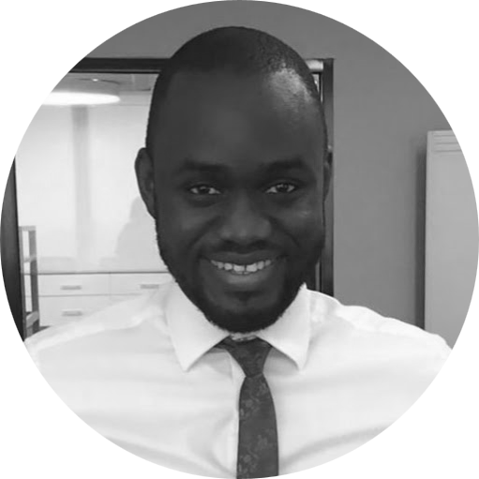
Mofe Binitie – Associate
Professional experience
Education and skills
Africa Foresight Group
Developed strategy to help to source crowd funding opportunities in Nigeria to support farms
2 years with EY Lagos, Nigeria as a Senior Associate (Transactions Advisory Services)
Provided due diligence, valuation, business plan assistance, lead advisory, financial model build and review services on transactions with deal value of over $1billion - exceeded expectations in all annual reviews
Advised the Federal Government of Nigeria, Nigeria Economic Summit Group and the Nigeria Liquefied Petroleum Gas Association on the development of a $3billion program for the substitution of firewood with liquefied petroleum gas
Part of the team that valued the unquoted equity investments of the Central Bank of Nigeria
Acted as transaction advisor to the Federal Government of Nigeria on the establishment of a $50million venture capital fund focused on small businesses
1 year with Wecyclers (Nigerian Recycling Company) Lagos, Nigeria
Interned with Weyclers business development team, Wecyclers is Lagos based start-up that helps low-income communities exchange their recyclable waste for cash and other rewards
Created the reporting dashboards for the Wecyclers collectors app that will serve 11,000 household in conjunction with the App development team
Mofe has an MBA from University of Oxford
He also holds a BSc in Economics and Statistics from University of Benin
Mofe is fluent in English and has basic skills in French
Introduction
Mofe Binitie is an Oxford-trained advisor with several years of transactions experience in the Nigerian market. He worked for both public and private sector clients during his time at Ernst & Young and is a World Economic Forum Global Shaper, serving as the Director of the Lagos hub of the program until he began studies in the UK. His focus at university was on finance.

